Slide 1
CS561 Fall 2018 Foundation of Artificial Intelligence
Neural Networks and Deep Learning
Tuesday Lectures, Session 20-21
6:40-7:55 & 8:05-9:20
Professor Wei-Min Shen

Slide 2

CS561 (Sessions 20-21): Today’s Topics
General Artificial Neural Networks and How They “Learn”
Back Propagation Algorithm (minimizing the errors)
Hopfield networks (minimizing the energy)
Deep Learning (go beyond simply classifications)
Google’s Tensor Flow
Convolution Neural Networks
Modeling the Brain (very ambitious)
Capabilities and Limitations (have we solved all the problems?)
Applications

Slide 3
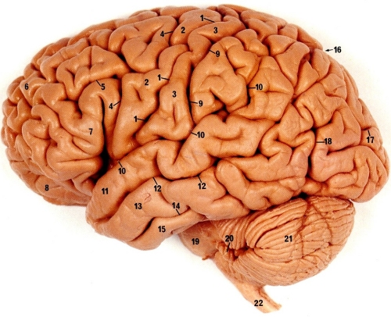
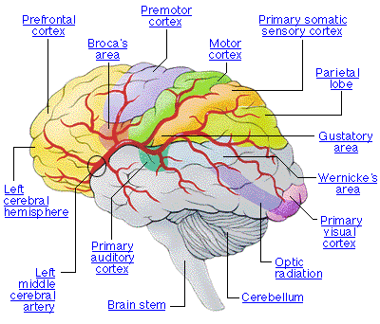
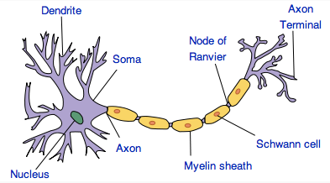
Neural Networks in Brain
Human brain is divided into regions with some functional specialization
E.g., Wernicke’s and Broca’s areas for language
Computation is driven by very large networks of rather slow neurons connected via synapses
10¹¹ neurons of > 20 types
10¹⁴ synapses
1-10ms cycle time
Signals are noisy spike trains of electrical potential
In AI/ML, models of neurons are highly simplified
New Discovery: Glial Cells in Brain boost learning

Slide 4
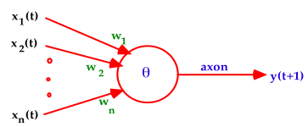
Warren McCulloch and Walter Pitts (1943)
A McCulloch-Pitts neuron operates on a discrete time-scale, t = 0,1,2,3, ... with time tick equal to one refractory period
At each time step, an input or output is
on or off — 1 or 0, respectively.
Each connection or synapse from the output of one neuron to the input of another, has an attached weight.
CS 561, Session 20

Slide 5
From Logical Neurons to Finite Automata
X₁
1
Brains, Machines, and
Mathematics, 2nd ed, 1987
AND
1.5
X₂
1
Boolean Net
X₁
1
→
Y
X Y
OR
0.5
1
X₂
NOT
X
X
0
Y
Finite
-1
Automaton
Y
Q
Hopfield Units
CS 561, Session 20

Slide 6
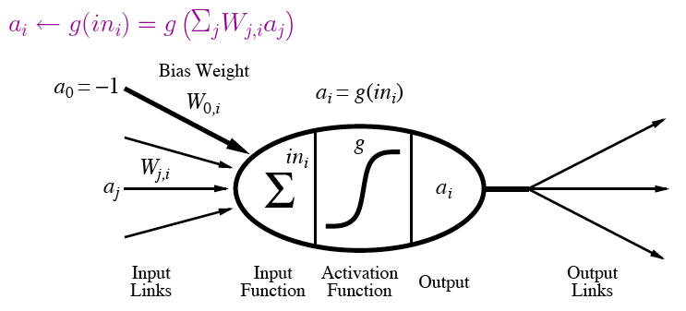
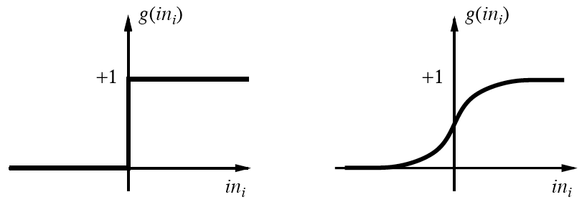
A modern variation of “Units”
Output is a “squashed” linear function of inputs:
Activation function can be step/threshold or sigmoid
Bias weight sets threshold for linear threshold unit

Slide 7
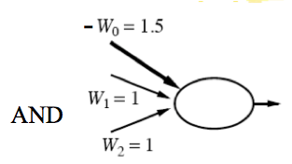
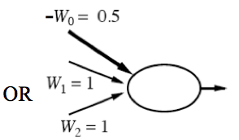
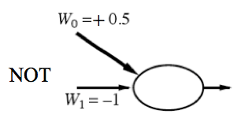
Implementing Logical Functions
Any Boolean function can be implemented in a network of linear threshold units (perceptrons)
But single layer networks are limited
E.g., cannot compute XOR
Minsky & Papert essentially killed off neural network field for a decade by showing this in 1969
Bias weight
Bias weight
Bias weight
Notes:
Ws are weights on inputs, not inputs.
Add all weighted inputs and see if >0

Slide 8
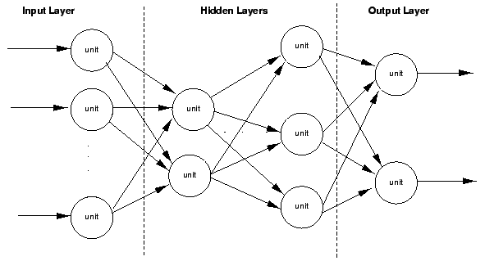
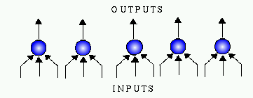
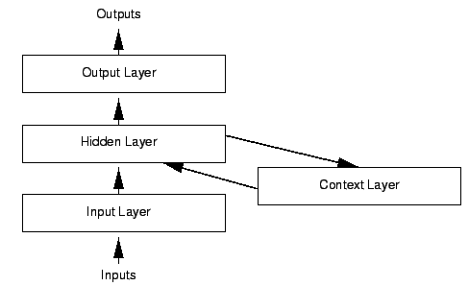
Variety of Network Structures
Feed-forward networks
May be single- or multi-layer
Implement functions/reflexes
No internal state
Recurrent networks
Directed cycles with delays
Internal state, like flip-flops
Dynamical systems
Hopfield networks
LTUs w/ symmetric weights
Minimize overall energy
Boltzmann machines
Stochastic, simulated annealing

Slide 9
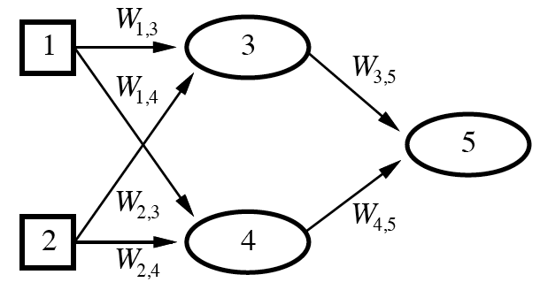
Feed-Forward Example
Feed-forward networks provide a parameterized family of nonlinear functions
a₅ = g(W_{3,5}a₃ + W_{4,5}a₄)
=g(W_{3,5}g(W_{1,3}a₁+W_{2,3}a₂) + W_{4,5}g(W_{1,4}a₁+W_{2,4}a₂))
Learning occurs by adjusting weights

Slide 10
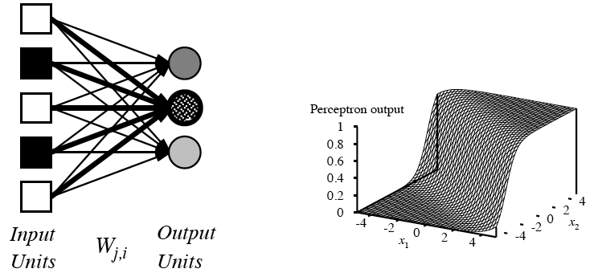
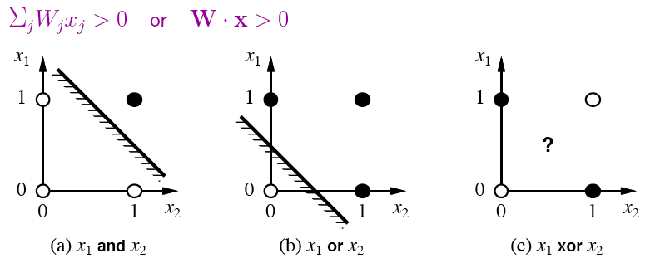
Single-Layer Perceptrons
Each output unit operates separately
Implements a linear separator
Adjusting weights alters location, orientation, and steepness of cliff

Slide 11
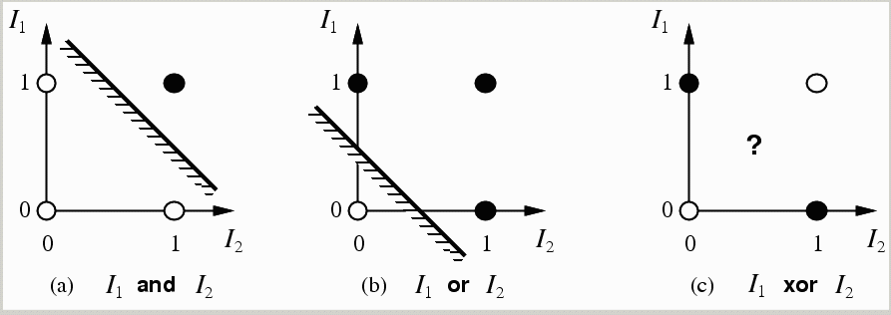
limitations of a single layer perceptron and linear separability problem
a single layer perceptron can only represent linearly separable functions which follows from the inequalities that determine its firing (Minsky & Papert(1969))
y(t+1) = 1 if and only if Σ w_{i}x_{i}(t) ≥ θ else y(t+1) = 0
i.e. input space is divided in 2
CS 561, Session 20

Slide 12
Perceptron Learning
Learn by adjusting weights on each iteration to reduce error
Gradient descent on squared error (y - out)²
Update rule for weights of a threshold function:
W_{j}’ = W_{j} + α(y - out)x_{j}
Comparable rules exist for differentiable activation functions
This perceptron learning rule is guaranteed to converge to a consistent function if the data is linearly separable
x₁
y
W₁
x₂
out
W₂
x₃
W₃
Notes:
y is the correct value on example x
out is the output of the neuron on example x
α is the learning rate
x_{j} is the value of the jth input to x (only modify weight if it actually contributed)
Modify weight according to the degree of error

Slide 13
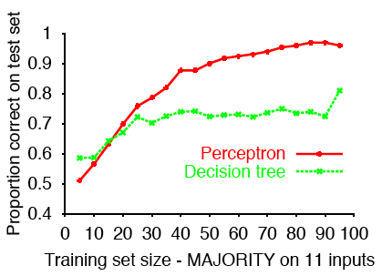
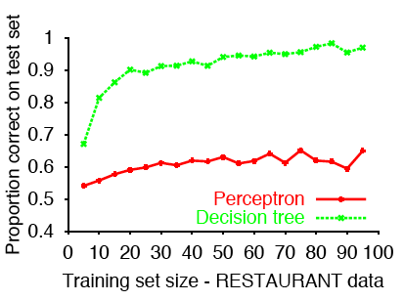
Sample Results
Perceptron learns majority function easily; DTL hopeless
Linearly separable, but difficult to express with yes/no splits on attributes without a path for each combination of attributes that would yield a majority
DTL learns restaurant function easily; single layer perceptron can’t represent it
Data came from a decision tree
Data is not linearly separable
( )
11
6

Slide 14
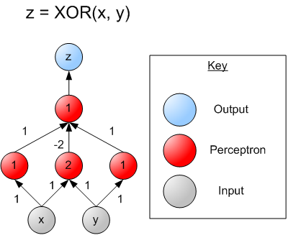
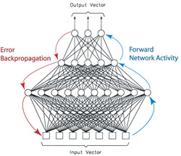
Multi-layer Perceptrons
single layer perceptrons can only represent linear decision surfaces
multi-layer perceptrons can represent non-linear decision surfaces.
CS 561, Session 20
14

Slide 15
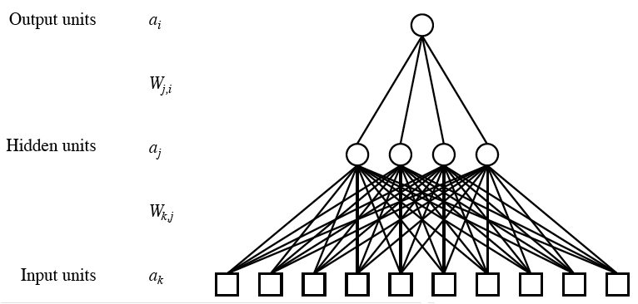
Multilayer Neural Networks
Units typically fully connected across layers unless have domain-specific knowledge to guide
Number of hidden units either chosen by hand or found via search
If too many, network will memorize input (overfitting)
If too few, function will be difficult to represent
As with Goldilocks, need it just right (to generalize)

Slide 16
Back-Propagation (learning) David E Rumelhart, Geoffrey E Hinton, and Ronald J Williams. Learning representations by back-propagating errors. Nature, 323(9) 533-536 1986. www.cs.toronto.edu/hinton/absps/naturebp.pdf.

Slide 17
Learn by Back-Propagation
Challenges for learning in networks with hidden units
Can’t directly compute error on output of hidden units because don’t have the true values for them
Also a clustering problem/opportunity
May yield new useful features
General approach is to (re)apportion error on output units to predecessors based on the weight of their connection, and continue this recursively backwards through the network

Slide 18
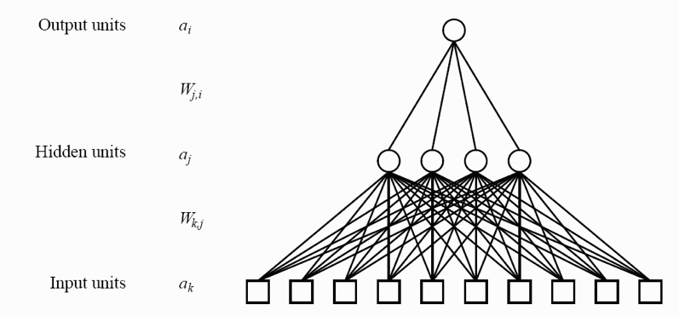
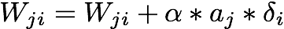
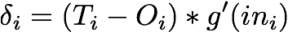
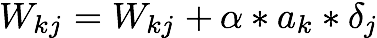
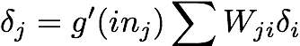
training a multilayer network using Backpropogation
CS 561, Session 20

Slide 19
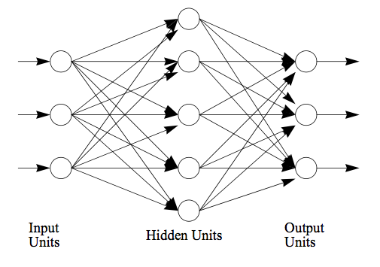
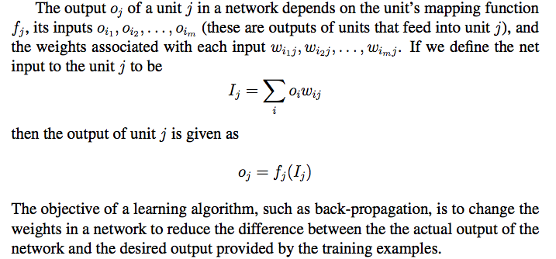
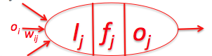
Neural Networks (The back-propagation math) (ALFE chapter 4)

Slide 20
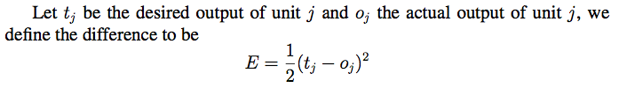
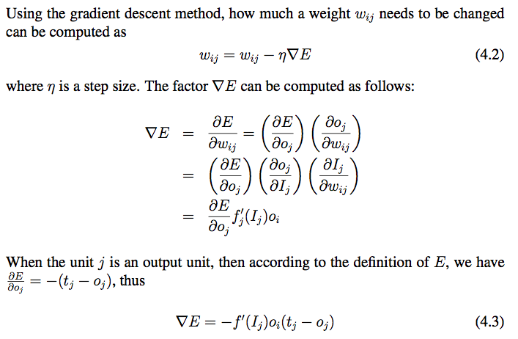
Back-Propagation (1/3)
i
j

Slide 21
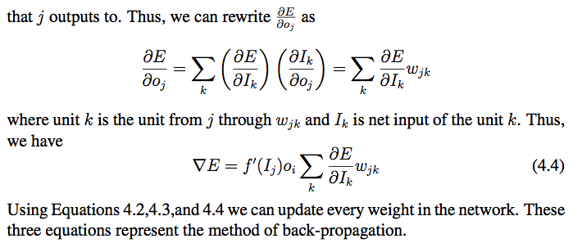
Back-Propagation (2/3)
j
k
i
, where

Slide 22
Back-Propagation (3/3)
Summery: change a link weight from unit i to j using these formulas:
i
j
When j is an output unit
When j is not an output unit
j
k
i

Slide 23
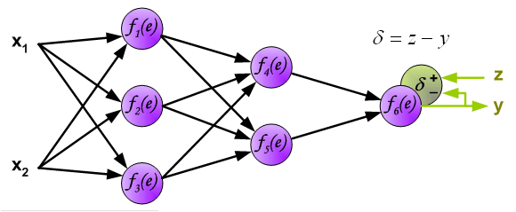
Example of Back-propagation
Note: δ here is equivalent to in the previous slides.

Slide 24
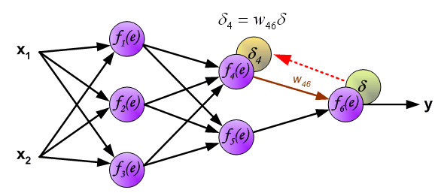
Example of Back-propagation

Slide 25
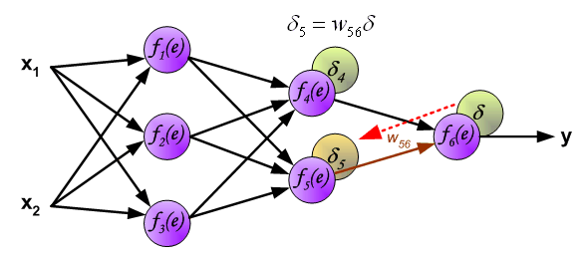
Example of Back-propagation

Slide 26
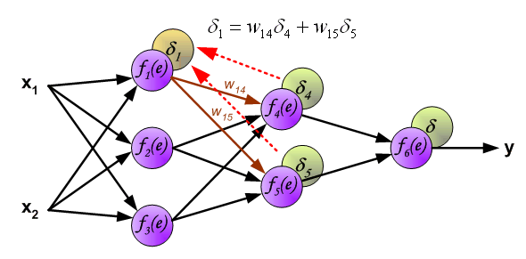
Example of Back-propagation

Slide 27
Some Comments on NNs So Far
Multi-layer networks can overcome the representational limitations of single-layer
Although may have issues with local minima
Recurrent networks are even more powerful, but more complex to understand and work with
Most common applications are in continuous perceptual or perceptuomotor domains
E.g., speech, driving, handwriting, fraud detection
Recently have been efforts to understand relationship between NN and Bayesian learning

Slide 28
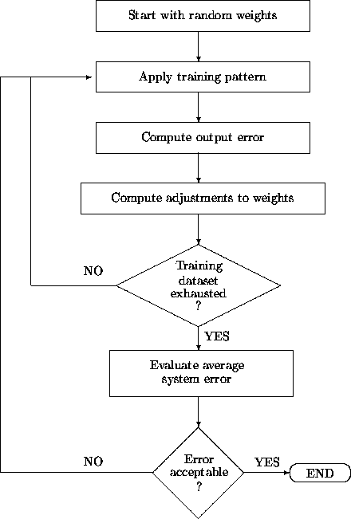
training a multilayer network
http://ams.egeo.sai.jrc.it/eurostat/Lot16-SUPCOM95/node7.html
CS 561, Session 20

Slide 29
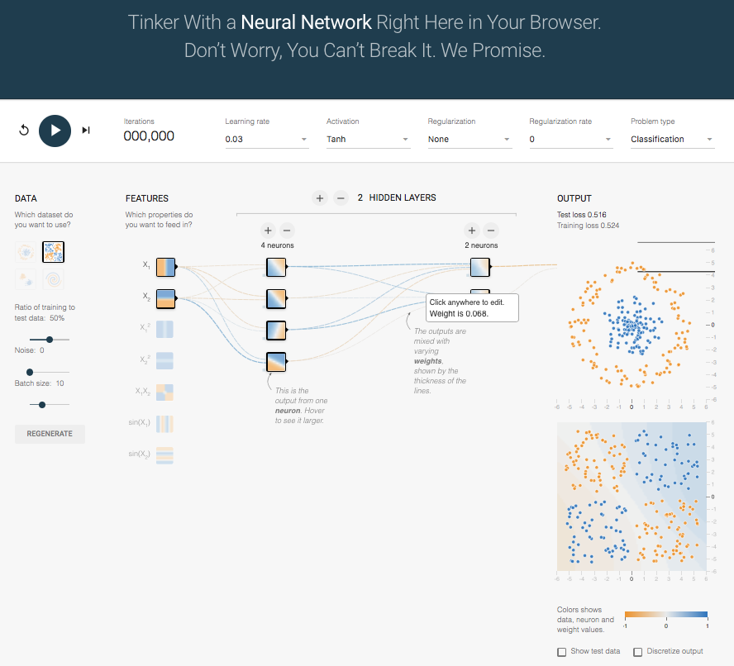
Neural Network Playground http://playground.tensorflow.org/
Play with this very nice website and you will learn a lot!

Slide 30
Hopfield Networks minimizing the energy (Note: Back-Propagation is to minimize the errors)

Slide 31
Hopfield Networks
A paper by John Hopfield in 1982 was the catalyst in attracting the attention of many physicists to "Neural Networks".
In a network of McCulloch-Pitts neurons
whose output is 1 iff Σwij sj ≥ θ_{i} and is otherwise 0,
neurons are updated synchronously: every neuron processes its inputs at each time step to determine a new output.
CS 561, Session 20

Slide 32
Hopfield Networks
A Hopfield net (Hopfield 1982) is a net of such units subject to the asynchronous rule for updating one neuron at a time:
"Pick a unit i at random.
If Σwij sj ≥ θ_{i}, turn it on.
Otherwise turn it off."
Moreover, Hopfield assumes symmetric weights:
wij = wji
CS 561, Session 20

Slide 33
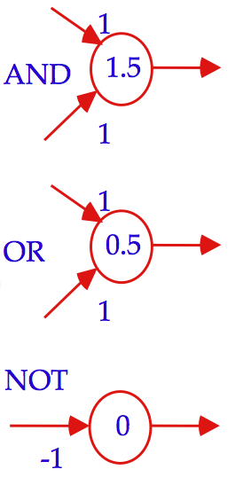
Different Representation of Units: MP vs Hopfield
CS 561, Session 20

Slide 34
“Energy” of a Neural Network
Hopfield defined the “energy”:
E = - ½ Σ _{ij} s_{i}s_{j}w_{ij} + Σ _{i} s_{i}θ_{i}
If we pick unit i and the firing rule (previous slide) does not change its s_{i}, it will not change E.
CS 561, Session 20

Slide 35
si: 0 to 1 transition
If s_{i} initially equals 0, and Σ w_{ij}s_{j} ≥ θ_{i}
then s_{i} goes from 0 to 1 with all other s_{j} constant,
and the "energy gap", or change in E, is given by
ΔE = - ½ Σ_{j} (w_{ij}s_{j} + w_{ji}s_{j}) + θ_{i}
= - (Σ _{j} w_{ij}s_{j} - θ_{i}) (by symmetry)
≤ 0.
CS 561, Session 20

Slide 36
si: 1 to 0 transition
If s_{i} initially equals 1, and Σ w_{ij}s_{j} < θ_{i}
then s_{i} goes from 1 to 0 with all other s_{j} constant
The "energy gap," or change in E, is given, for symmetric w_{ij}, by:
ΔE = Σ_{j} w_{ij}s_{j} - θ_{i} < 0
So, on every updating we have ΔE ≤ 0
CS 561, Session 20

Slide 37
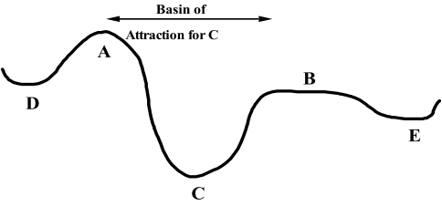
Minimizing the Energy
On every updating we have ΔE ≤ 0
Hence the dynamics of the net tends to move E toward a minimum.
We stress that there may be different such states — they are local minima. Global minimization is not guaranteed.
CS 561, Session 20

Slide 38
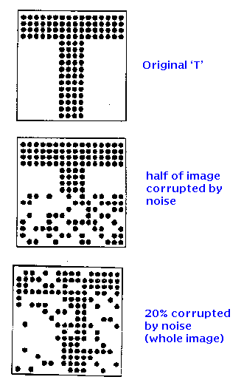
Associative Memories
http://www.shef.ac.uk/psychology/gurney/notes/l5/l5.html
Idea: store:
So that we can recover it if presented
with corrupted data such as:
Or:
CS 561, Session 20

Slide 39
Hopfield applet
CS 561, Session 20

Slide 40
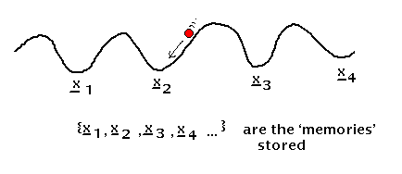
Associative memory with Hopfield nets
Setup a Hopfield net such that local minima correspond
to the stored patterns.
Issues:
- because of weight symmetry, anti-patterns (binary reverse) are stored as well as the original patterns (also spurious local minima are created when many patterns are stored)
- if one tries to store more than about 0.14*(number of neurons) patterns, the network exhibits unstable behavior
- works well only if patterns are uncorrelated
CS 561, Session 20

Slide 41
Deep Learning (Introduction)

Slide 42

Deep Mind (Learning to Play Games and Go)

Slide 43
Buzz…

Slide 44

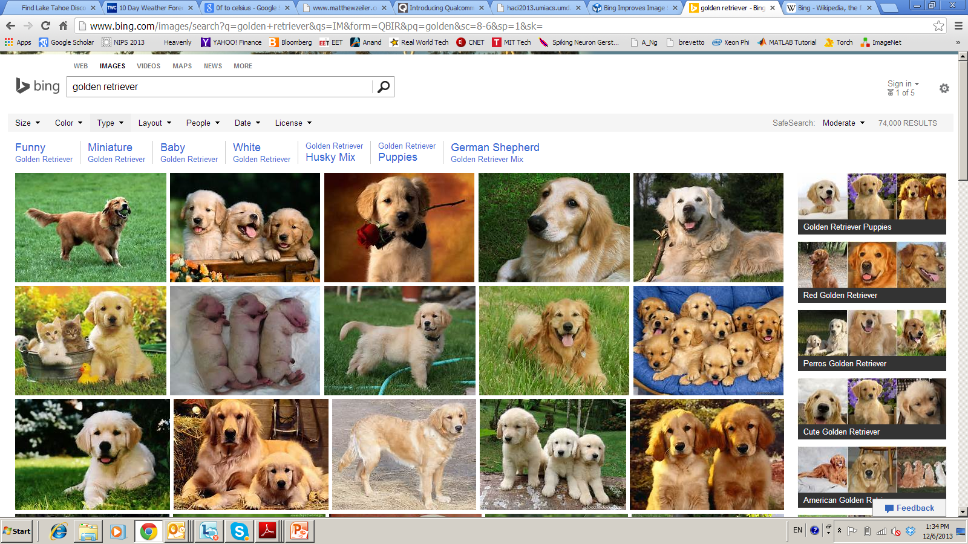




Deep Learning – from Research to Technology
Deep Learning - breakthrough in visual and speech recognition

Slide 45

Classical Computer Vision Pipeline

Slide 46
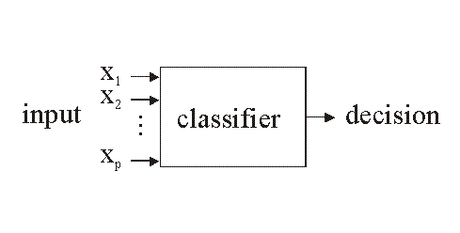
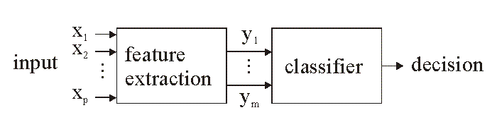
Go beyond the Simple Classification: Feature Extraction
Human
designed
features
ML designed
features
Raw images
(No features)
http://www.electronicsletters.com/papers/2001/0020/paper.asp
CS 561, Session 20

Slide 47
Classical Computer Vision Pipeline.
CV experts
Select / develop features: SURF, HoG, SIFT, RIFT, …
Add on top of this Machine Learning for multi-class recognition and train classifier
Feature
Extraction:
SIFT, HoG...
Detection,
Classification
Recognition
Classical CV feature definition is domain-specific and time-consuming

Slide 48
Deep Learning –based Vision Pipeline.
Deep Learning:
Build features automatically based on training data
Combine feature extraction and classification
DL experts: define NN topology and train NN
Deep NN...
Deep NN...
Detection,
Classification
Recognition
Deep Learning promise:
train good feature automatically,
same method for different domain

Slide 49
Computer Vision + Deep Learning + Machine Learning
We want to combine Deep Learning + CV + ML
Combine pre-defined features with learned features;
Use best ML methods for multi-class recognition
CV+DL+ML experts needed to build the best-in-class
CV
features
HoG, SIFT
Deep
NN...
ML
AdaBoost
…
Combine best of Computer Vision
Deep Learning and Machine Learning

Slide 50
Deep Learning Basics
Deep Learning – is a set of machine learning algorithms based on multi-layer networks
CAT
DOG
OUTPUTS
HIDDEN
NODES
INPUTS

Slide 51






Deep Learning Basics
Deep Learning – is a set of machine learning algorithms based on multi-layer networks
CAT
DOG
Training

Slide 52

Deep Learning Basics
Deep Learning – is a set of machine learning algorithms based on multi-layer networks
CAT
DOG

Slide 53
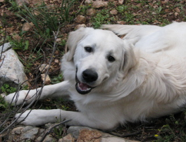
Deep Learning Basics
Deep Learning – is a set of machine learning algorithms based on multi-layer networks
CAT
DOG

Slide 54
Deep Learning Taxonomy
Supervised:
Convolutional NN ( LeCun)
Recurrent Neural nets (Schmidhuber )
Unsupervised
Deep Belief Nets / Stacked RBMs (Hinton)
Stacked denoising autoencoders (Bengio)
Sparse AutoEncoders ( LeCun, A. Ng, )

Slide 55
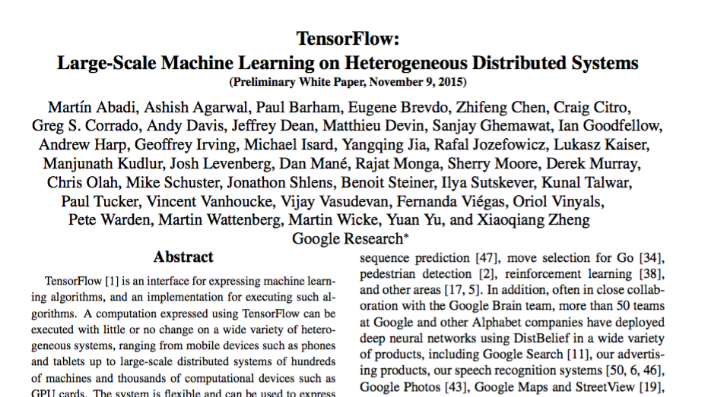
Google’s TensorFlow Algorithm (highly recommended)

Slide 56
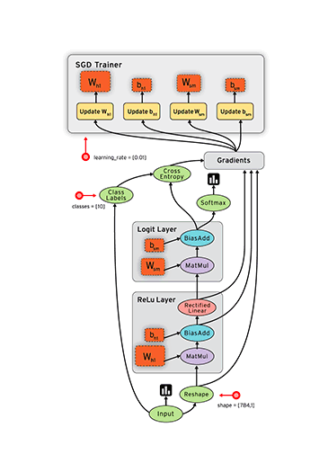
TensorFlow Graph

Slide 57
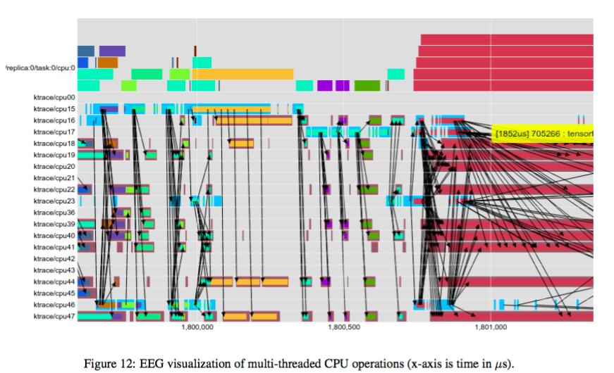
TensorFlow Highlights

Slide 58
Face Recognition (Example)

Slide 59
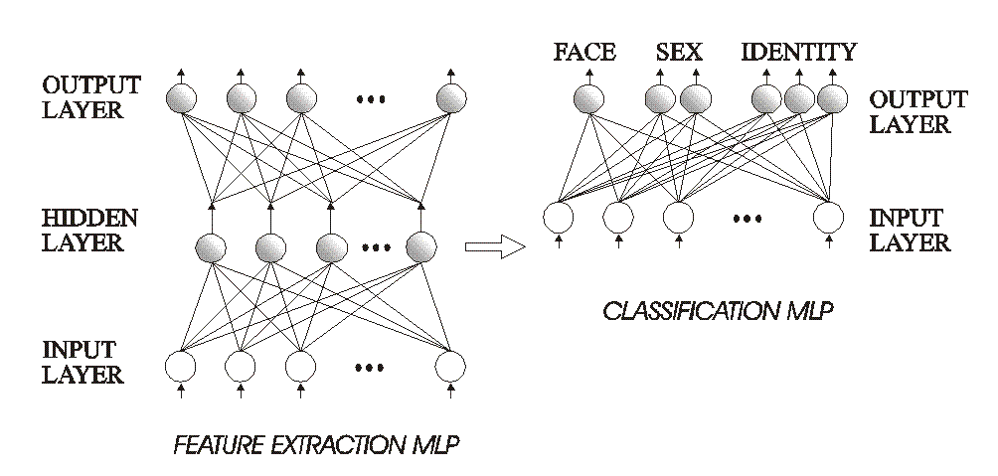
Example: Face Recognition
Using the 2-stage approach (feature extraction + Classification)
CS 561, Session 20

Slide 60

Training
http://www.neci.nec.com/homepages/lawrence/papers/face-tr96/latex.html
CS 561, Session 20

Slide 61

Learning rate
CS 561, Session 20

Slide 62

Testing / Evaluation
Look at performance as a function of network complexity
CS 561, Session 20

Slide 63

Testing / Evaluation
Comparison with other known techniques
CS 561, Session 20

Slide 64
Convolutional Networks

Slide 65
Acknowledgments
The presentation in this section is heavily based on:
John Canny (Fall 2016)
Lecture 6: Projects and Training Neural Networks I
Notes from Andrej Karpathy, Fei-Fei Li, Justin Johnson
http://cs.nyu.edu/~fergus/pmwiki/pmwiki.php
http://deeplearning.net/reading-list/tutorials/
http://deeplearning.net/tutorial/lenet.html
http://ufldl.stanford.edu/wiki/index.php/UFLDL_Tutorial
… and many other

Slide 66
Convolutional NN
Convolutional Neural Networks is extension of traditional Multi-layer Perceptron, based on 3 ideas:
Local receive fields
Shared weights
Spatial / temporal sub-sampling
See LeCun paper (1998) on text recognition:
http://yann.lecun.com/exdb/publis/pdf/lecun-01a.pdf

Slide 67

What Is Convolutional NN ?
CNN - multi-layer NN architecture
Convolutional + Non-Linear Layer
Sub-sampling Layer
Convolutional +Non-Linear Layer
Fully connected layers
Supervised
Feature Extraction
Classi-
fication

Slide 68

What is Convolutional NN ?
2x2
Convolution + NL
Sub-sampling
Convolution + NL

Slide 69

CNN success story: ILSVRC 2012
Imagenet data base: 14 mln labeled images, 20K categories

Slide 70
ILSVRC: Classification

Slide 71
Imagenet Classifications 2012

Slide 72
ILSVRC 2012: top rankers
http://www.image-net.org/challenges/LSVRC/2012/results.html
N | Error-5 | Algorithm | Team | Authors
1 | 0.153 | Deep Conv. Neural Network | Univ. of Toronto | Krizhevsky et al
2 | 0.262 | Features + Fisher Vectors + Linear classifier | ISI | Gunji et al
3 | 0.270 | Features + FV + SVM | OXFORD_VGG | Simonyan et al
4 | 0.271 | SIFT + FV + PQ + SVM | XRCE/INRIA | Perronin et al
5 | 0.300 | Color desc. + SVM | Univ. of Amsterdam | van de Sande et al

Slide 73
Imagenet 2013: top rankers
http://www.image-net.org/challenges/LSVRC/2013/results.php
N | Error-5 | Algorithm | Team | Authors
1 | 0.117 | Deep Convolutional Neural Network | Clarifi | Zeiler
2 | 0.129 | Deep Convolutional Neural Networks | Nat.Univ Singapore | Min LIN
3 | 0.135 | Deep Convolutional Neural Networks | NYU | Zeiler Fergus
4 | 0.135 | Deep Convolutional Neural Networks |  | Andrew Howard
5 | 0.137 | Deep Convolutional Neural Networks | Overfeat NYU | Pierre Sermanet et al

Slide 74

Imagenet Classifications 2013

Slide 75
Conv Net Topology
5 convolutional layers
3 fully connected layers + soft-max
650K neurons , 60 Mln weights

Slide 76





CNN applications
CNN is a big hammer
Plenty low hanging fruits
You need just a right nail!

Slide 77
Conv NN: Detection
Sermanet, CVPR 2014

Slide 78
Conv NN: Scene parsing
Farabet, PAMI 2013

Slide 79
CNN: indoor semantic labeling RGBD
Farabet, 2013

Slide 80
Conv NN: Action Detection
Taylor, ECCV 2010

Slide 81

Conv NN: Image Processing
Eigen , ICCV 2010

Slide 82


Machine Translation
Use sequence-to-sequence models + attention.
“Effective Approaches to Attention-based Neural Machine Translation” Minh-Thang Luong, Hieu Pham, Christopher D. Manning
Datasets: see paper

Slide 83

End-To-End Memory Networks
End to End Memory Networks (Tensorflow versions exist here and here)
Paper: S. Sukhbaatar, A. Szlam, J. Weston, and R. Fergus. End-to-end memory networks Dataset: https://research.facebook.com/research/babi/

Slide 84

Deep Speech 2
Paper: Dario Amodei et al. “Deep Speech 2: End-to-End Speech Recognition in English and Mandarin”. Torch code: Here and here is an intro.
Datasets: TIMIT continuous speech data, WMT ‘15.

Slide 85

Variational AutoEncoders
Paper: D. Kingma and M. Welling. “Stochastic Gradient VB and the Variational Auto-Encoder” Dataset: MNIST, Could try CIFAR 10 or 100 or ImageNet

Slide 86

Residual Networks
Paper: Kaiming He et. al. “Deep Residual Learning for Image Recognition”
Torch code here
Dataset is CIFAR 10 or 100 or ImageNet

Slide 87
VGG: Oxford Group Network
Paper: Karen Simonyan and Andrew Zisserman. “Very Deep Convolutional Networks for Large-Scale Image Recognition”
Dataset is CIFAR 10 or 100 or ImageNet

Slide 88

Deep Reinforcement Learning
Paper: Volodymyr Minh et. al. “Playing Atari with Deep Reinforcement Learning”. Dataset: http://www.arcadelearningenvironment.org/

Slide 89

Inception/GooLeNet
Paper: Szegedy, C., Liu, W., Jia, Y., Sermanet, P., Reed, S., Anguelov, D., Erhan, D., Vanhoucke, V., and Rabinovich, A. Going deeper with convolutions
Dataset: CIFAR 10 or 100 or ImageNet

Slide 90

Fast R-CNN
Paper: Ross Girshick “Fast R-CNN”
Datasets: Pascal VOC07

Slide 91

WaveNet
Paper: van den Oord et al: “WAVENET: A GENERATIVE MODEL FOR RAW AUDIO”
Dataset: VCTK (see paper)

Slide 92
Others
Object detection and localization
SSD: Single shot multibox detector https://arxiv.org/abs/1512.02325
in Caffe here: https://github.com/weiliu89/caffe/tree/ssd
R-FCN: Object detection via region based fully convolutional networks:
https://arxiv.org/abs/1605.06409
Caffe code here: https://github.com/daijifeng001/caffe-rfcn
Semantic Segmentation:
SegNet: A Deep Convolutional Encoder-Decoder Architecture for Robust Semantic Pixel-Wise Labelling http://arxiv.org/abs/1505.07293
Code in caffe here: https://github.com/alexgkendall/caffe-segnet
Fully Convolutional Networks for Semantic Segmentation
https://arxiv.org/abs/1411.4038
In Caffe branch: https://github.com/BVLC/caffe

Slide 93
Modeling the Brain

Slide 94
General Comments: Artificial Neural Networks and AI
Artificial Neural Networks provide…
A new computing paradigm
A technique for developing trainable classifiers, memories, dimension-reducing mappings, etc
A tool to study brain function
CS 561, Session 20

Slide 95
Converging Frameworks
Artificial intelligence (AI): build a “packet of intelligence” into a machine
Cognitive psychology: explain human behavior by interacting processes (schemas) “in the head” but not localized in the brain
Brain Theory: interactions of components of the brain -
- computational neuroscience
- neurologically constrained-models
and abstracting from them as both Artificial intelligence and Cognitive psychology:
- connectionism: networks of trainable “quasi-neurons” to provide “parallel distributed models” little constrained by neurophysiology
- abstract (computer program or control system) information processing models
CS 561, Session 20

Slide 96

CS 561, Session 20

Slide 97

Major Functional Areas
Primary motor: voluntary movement
Primary somatosensory: tactile, pain, pressure, position, temp., mvt.
Motor association: coordination of complex movements
Sensory association: processing of multisensory information
Prefrontal: planning, emotion, judgement
Speech center (Broca’s area): speech production and articulation
Wernicke’s area: comprehen-
sion of speech
Auditory: hearing
Auditory association: complex
auditory processing
Visual: low-level vision
Visual association: higher-level
vision
CS 561, Session 20

Slide 98

Interconnect
Felleman & Van Essen, 1991
CS 561, Session 20

Slide 99

Remember? Neurons & synapses
Key terms:
Axon
Dendrites
Synapses
Soma (cell body)
CS 561, Session 20

Slide 100

Electron Micrograph of a Real Neuron
CS 561, Session 20

Slide 101
Approaches to neural modeling
Biologically-realistic, detailed models
E.g., cable equation, multi-compartment models
The Hodgkin-Huxley model
Simulators like NEURON (Yale) or GENESIS (Caltech)
More abstract models, still keeping realism in mind
E.g., integrate & fire model, simple and low detail but preserves spiking behavior
Highly abstract models, neurons as operators
E.g., McCulloch & Pitts model
Classical “neural nets” modeling
CS 561, Session 20

Slide 102


Detailed Neural Modeling
A simulator, called “Neuron” has been developed at Yale to simulate the Hodgkin-Huxley equations, as well as other membranes/channels/etc. See http://www.neuron.yale.edu/
CS 561, Session 20

Slide 103

The Cable Equation
See
http://diwww.epfl.ch/~gerstner/SPNM/SPNM.html
for excellent additional material (some reproduced here).
Just a piece of passive dendrite can yield complicated differential equations which have been extensively studied by electronicians in the context of the study of coaxial cables (TV antenna cable):
CS 561, Session 20

Slide 104


The Hodgkin-Huxley Model
Example spike trains obtained…
CS 561, Session 20

Slide 105

Leaky Integrator Neuron
The simplest "realistic" neuron model is a continuous time model based on using the firing rate (e.g., the number of spikes traversing the axon in the most recent 20 msec.) as a continuously varying measure of the cell's activity
The state of the neuron is described by a single variable, the membrane potential.
The firing rate is approximated by a sigmoid, function of membrane potential.
CS 561, Session 20

Slide 106
Leaky Integrator Model
m(t)
τ = - m(t) + h
has solution m(t) = e^{-t/τ} m(0) + (1 - e^{-t/τ})h
→ h for time constant τ > 0.
We now add synaptic inputs to get the
Leaky Integrator Model:
τ = - m(t) + Σ _{i} w_{i} X_{i}(t) + h
where X_{i}(t) is the firing rate at the i^{th} input.
Excitatory input (w_{i} > 0) will increase
Inhibitory input (w_{i} < 0) will have the opposite effect.
X(t) = g(m(t)) with g() a sigmoid relates output to membrane potential
m(t)
m(t)
CS 561, Session 20

Slide 107

The "basic" biological neuron
The soma and dendrites act as the input surface; the axon carries the outputs.
The tips of the branches of the axon form synapses upon other neurons or upon effectors (though synapses may occur along the branches of an axon as well as the ends). The arrows indicate the direction of "typical" information flow from inputs to outputs.
CS 561, Session 20

Slide 108

Vision, AI and ANNs
1940s: beginning of Artificial Neural Networks
McCullogh & Pitts, 1942
Σ_{i} w_{i}x_{i} ≥ θ
Perceptron learning rule (Rosenblatt, 1962)
Backpropagation
Hopfield networks (1982)
Kohonen self-organizing maps
…
CS 561, Session 20

Slide 109
Excitatory and Inhibitory Synapses
We call a synapse
excitatory if w_{i} > 0, and
inhibitory if w_{i} < 0.
We also associate a threshold θ with each neuron
A neuron fires (i.e., has value 1 on its output line) at time t+1 if the weighted sum of inputs at t reaches or passes θ:
y(t+1) = 1 if and only if Σ w_{i}x_{i}(t) ≥ θ
CS 561, Session 20

Slide 110
Increasing the Realism of Neuron Models
The McCulloch-Pitts neuron of 1943 is important
as a basis for
logical analysis of the neurally computable, and
current design of some neural devices (especially when augmented by learning rules to adjust synaptic weights).
However, it is no longer considered a useful model for making contact with neurophysiological data concerning real neurons.
CS 561, Session 20

Slide 111


Deep neural networks
ImageNet visual recognition
challenge: recognize objects,
animals, people, etc (200 categories)
in photographs.
CS 561, Session 20

Slide 112

Deep neural networks
Top performers for the 2014 challenge (including winner) are deep neural networks!
CS 561, Session 20

Slide 113

Deep neural networks
Very deep layered network (27 layers) with hundreds of millions of parameters.
Trained on very large datasets at Google.
CS 561, Session 20

Slide 114
Capabilities & Limitations

Slide 115



Capabilities and Limitations of Layered Networks
Have we solved all the problems?
What about new tasks/environments?
switch the keys on keyboard?
Twisting the camera?
Issues:
what can given networks do?
What can they learn to do?
How many layers required for given task?
How many units per layer?
When will a network generalize?
What do we mean by generalize?
…
CS 561, Session 20

Slide 116
Capabilities and Limitations of Layered Networks
What about boolean functions?
Single-layer perceptrons are very limited:
- XOR problem
- etc.
But what about multilayer perceptrons?
We can represent any boolean function with a network with just one hidden layer.
How??
CS 561, Session 20

Slide 117
Capabilities and Limitations of Layered Networks
To approximate a set of functions of the inputs by a layered network with continuous-valued units and sigmoidal activation function…
Cybenko, 1988: … at most two hidden layers are necessary, with arbitrary accuracy attainable by adding more hidden units.
Cybenko, 1989: one hidden layer is enough to approximate any continuous function.
Intuition of proof: decompose function to be approximated into a sum of localized “bumps.” The bumps can be constructed with two hidden layers.
Similar in spirit to Fourier decomposition. Bumps = radial basis functions.
CS 561, Session 20

Slide 118
Optimal Network Architectures
How can we determine the number of hidden units?
genetic algorithms: evaluate variations of the network, using a metric that combines its performance and its complexity. Then apply various mutations to the network (change number of hidden units) until the best one is found.
Pruning and weight decay:
- apply weight decay (remember reinforcement learning) during training
- eliminate connections with weight below threshold
- re-train
- How about eliminating units? For example, eliminate units with total synaptic input weight smaller than threshold.
CS 561, Session 20

Slide 119
For further information
See
Hertz, Krogh & Palmer: Introduction to the theory of neural computation (Addison Wesley)
In particular, the end of chapters 2 and 6.
CS 561, Session 20

Slide 120
Applications

Slide 121
Applications: Classification
Business
Credit rating and risk assessment
Insurance risk evaluation
Fraud detection
Insider dealing detection
Marketing analysis
Mailshot profiling
Signature verification
Inventory control
Security
Face recognition
Speaker verification
Fingerprint analysis
Medicine
General diagnosis
Detection of heart defects
Engineering
Machinery defect diagnosis
Signal processing
Character recognition
Process supervision
Process fault analysis
Speech recognition
Machine vision
Speech recognition
Radar signal classification
Science
Recognising genes
Botanical classification
Bacteria identification
CS 561, Session 20

Slide 122
Applications: Modelling
Business
Prediction of share and commodity prices
Prediction of economic indicators
Insider dealing detection
Marketing analysis
Mailshot profiling
Signature verification
Inventory control
Engineering
Transducer linerisation
Colour discrimination
Robot control and navigation
Process control
Aircraft landing control
Car active suspension control
Printed Circuit auto routing
Integrated circuit layout
Image compression
Science
Prediction of the performance of drugs from the molecular structure
Weather prediction
Sunspot prediction
Medicine
. Medical imaging and image processing
CS 561, Session 20

Slide 123
Applications: Forecasting
Future sales
Production Requirements
Market Performance
Economic Indicators
Energy Requirements
Time Based Variables
CS 561, Session 20

Slide 124
Applications: Novelty Detection
Fault Monitoring
Performance Monitoring
Fraud Detection
Detecting Rate Features
Different Cases
CS 561, Session 20

